Slide 1
Chapter
7
Telecommunications, the Internet, and Wireless Technology
Notes:
There are two video cases available for this chapter:
Case 1: Telepresence Moves Out of the Boardroom and Into the Field
Case 2: Virtual Collaboration with IBM Sametime

Slide 2
Essentials of Management Information Systems
Chapter 7 Telecommunications, the Internet, and
Wireless Technology
STUDENT LEARNING OBJECTIVES
What are the principal components of telecommunications networks and key networking technologies?
What are the different types of networks?
How do the Internet and Internet technology work and how do they support communication and
e-business?
Notes:
This chapter discusses the principle technologies used in networking and the Internet. Ask students how many networks to they belong to? Local Area Networks at work; home wireless networks; the Internet; cellular networks; cable networks. How would they feel if they lost any of these networks?

Slide 3
Essentials of Management Information Systems
Chapter 7 Telecommunications, the Internet, and
Wireless Technology
STUDENT LEARNING OBJECTIVES
What are the principal technologies and standards for wireless networking, communication, and Internet access?
Notes:
This chapter discusses the principle technologies used in networking and the Internet. Ask students how many networks to they belong to? Local Area Networks at work; home networks; the Internet; cellular networks; cable networks. How would they feel if they lost any of these networks?

Slide 4
Essentials of Management Information Systems
Chapter 7 Telecommunications, the Internet, and
Wireless Technology
Student Support Materials
Learning Tracks
Broadband Network Services and Technologies
Cellular System Generations
Wireless Applications for Customer Relationship Management, Supply Chain Management, and Healthcare
Introduction to Web 2.0
Video Cases
Case 1: Telepresence Moves Out of the Boardroom and Into the Field
Case 2: Virtual Collaboration with IBM Sametime

Slide 5
Essentials of Management Information Systems
Chapter 7 Telecommunications, the Internet, and
Wireless Technology
RFID and Wireless Technology Speed Up Production at Continental Tires
Problem: Inefficient manual processes; large production environment
Solutions: Track components in real time, optimize transportation, and expedite communication
  Wi-Fi networks
  RFID technologies
  Mobile handhelds
  Material inventory tracking software
Demonstrates use of technology in production and supply chain to increase efficiency and lower costs

Slide 6
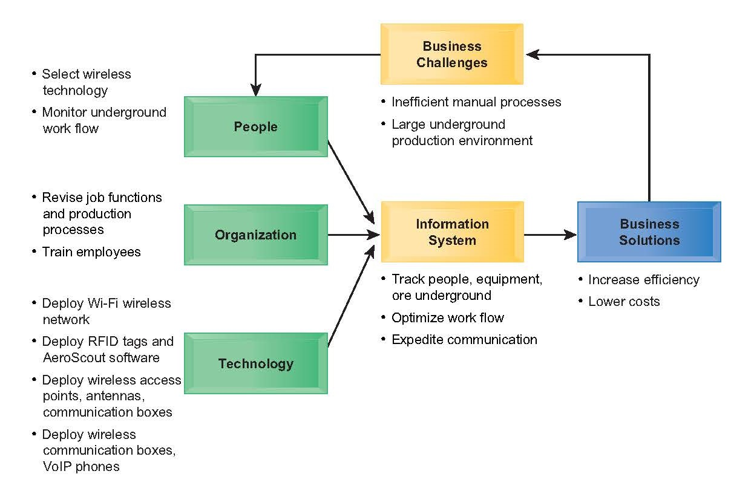
Essentials of Management Information Systems
Chapter 7 Telecommunications, the Internet, and
Wireless Technology
RFID and Wireless Technology Speed Up Production at Continental Tires

Slide 7
Essentials of Management Information Systems
Chapter 7 Telecommunications, the Internet, and
Wireless Technology
What are the principal components of telecommunications networks and key networking technologies?
Networking and Communication Trends
Convergence:
  Telephone networks and computer networks converging into single digital network using Internet standards
  Cable companies providing voice service
Broadband:
  More than 75 percent U.S. Internet users have broadband access
Broadband wireless:
  Voice and data communication as well as Internet access are increasingly taking place over broadband wireless platforms
Notes:
This slide discusses recent developments in networking technologies. Ask students to give an example of convergence. How fast is broadband today? How many of your students have broadband? Note that in 2000, typical Internet access speeds were 56 kbps over a telephone line, costing 25 cents per kilobit, whereas today broadband speeds are 1 to 5 mbps, costing 1 cent per kilobit (or 10 cents per gigabit). Are students aware of how fast their Internet connections are at home, school, or work? Ask students if they know the speed of their cell phone’s Internet connection. The point here is to try and raise awareness of telecommunications systems among students. Have they had issues playing Netflix movies at home?

Slide 8
Essentials of Management Information Systems
Chapter 7 Telecommunications, the Internet, and
Wireless Technology
Principal components of telecommunications networks and key networking technologies?
What Is a Computer Network?
Major components in simple network
  Client computer
  Server computer
  Network interfaces
  Connection medium
  Network operating system (NOS)
  Hub or switch
Routers
Software defined networking (SDN)
Notes:
This slide describes what a network is along with the components that you will find in a simple network (illustrated on the next slide.) Ask students to describe the function of a client and a server on a network. What is a connection medium? Ask students to describe the purpose of a hub, switch, and router.

Slide 9
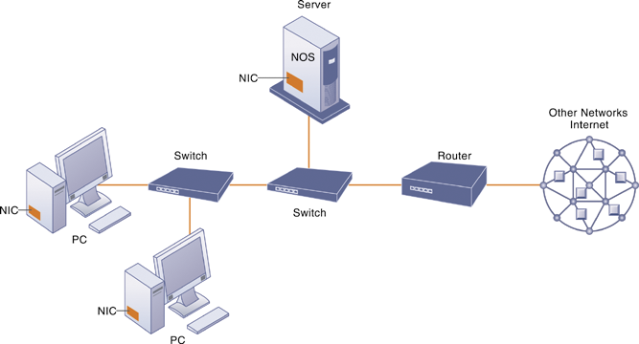
Essentials of Management Information Systems
Chapter 7 Telecommunications, the Internet, and
Wireless Technology
Principal components of telecommunications networks and key networking technologies?
Components of a Simple Computer Network
Illustrated here is a very simple computer network, consisting of computers, a network operating system residing on a dedicated server computer, cabling (wiring) connecting the devices, network interface cards (NIC), switches, and a router.
Figure 7.1
Notes:
This graphic illustrates the components of a simple network. Although the NOS is shown as part of the server, note that, depending on the type of software, an NOS may also be designed to reside on client computers (these are called peer-to-peer networks). Do some students have a home computer WiFi network? Ask them to describe the elements of that network.

Slide 10
Essentials of Management Information Systems
Chapter 7 Telecommunications, the Internet, and
Wireless Technology
Principal components of telecommunications networks and key networking technologies?
Networks in Large Companies
Components include:
  Hundreds of local area networks (LANs) linked to firmwide corporate network
  Various powerful servers
    Web site
    Corporate intranet, extranet
    Backend systems
  Mobile wireless LANs (Wi-Fi networks)
  Videoconferencing system
  Telephone network
  Wireless cell phones
Notes:
This slide looks at the additional components one might expect to find in the network of a large company that has many locations and thousands of employees (illustrated on the next slide). Ask students what is meant by “backend systems.” Note that many firms are dispensing with traditional landline telephone networks and using Internet telephones that run on existing internal data networks and the Internet.

Slide 11
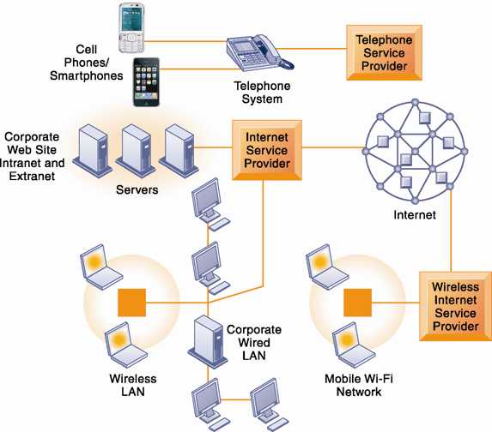
Essentials of Management Information Systems
Chapter 7 Telecommunications, the Internet, and
Wireless Technology
Principal components of telecommunications networks and key networking technologies?
Corporate Network Infrastructure
Today’s corporate network infrastructure is a collection of many different networks from the public switched telephone network, to the Internet, to corporate local area networks linking workgroups, departments, or office floors.
Figure 7.2
Notes:
This graphic illustrates the components of a large company’s network. Note the difference between the wireless LAN, which allows wireless access within the office, and the mobile Wi-Fi network, which allows Internet access to employees outside of offices. The advantage of telephone-based wireless systems is that they do not require a Wi-Fi hotspot to work, and in fact can connect users to the entire globe through their telephone networks. Cable networks—major competitors of telephone company Internet providers—have recently developed a mobile option. Optimum Cable (Comcast) has installed neighborhood Wi-Fi hot spots, allowing cable subscribers wireless access to the Internet.

Slide 12
Essentials of Management Information Systems
Chapter 7 Telecommunications, the Internet, and
Wireless Technology
Principal components of telecommunications networks and key networking technologies?
Key Digital Networking Technologies
Client/server computing
  Distributed computing model
  Clients linked through network controlled by network server computer
  Server sets rules of communication for network and provides every client with an address so others can find it on the network
  Has largely replaced centralized mainframe computing
  The Internet: largest implementation of client/server computing
Notes:
This slide and following two slides look at the main technologies in use today for networks: client/server computing, packet switching, and TCP/IP. Ask students what advantages client/server computing has over centralized mainframe computing.

Slide 13
Essentials of Management Information Systems
Chapter 7 Telecommunications, the Internet, and
Wireless Technology
Principal components of telecommunications networks and key networking technologies?
Key Digital Networking Technologies
Packet switching
  Method of slicing digital messages into parcels (packets), sending packets along different communication paths as they become available, and then reassembling packets at destination
  Previous circuit-switched networks required assembly of complete point-to-point circuit
  Packet switching more efficient use of network’s communications capacity
Notes:
This slide continues the discussion of the three main networking technologies today, looking at the second, packet switching. Note that circuit-switched networks were expensive and wasted available communications capacity—the circuit had to be maintained whether data was being sent or not. It is also important to note that packet switching enables packets to follow many different paths. What is the advantage of this capability? If one path is blocked due to an accident or power failure, the data will automatically be shifted by routers to open paths. However, in truly massive outages like the September 11, 2011 attack on the World Trade Center, nearby metropolitan servers were knocked out, and for a period of several days, Internet access was limited in the New York Metropolitan area. The notion that packet switching networks would survive a nuclear attack is highly unlikely.

Slide 14
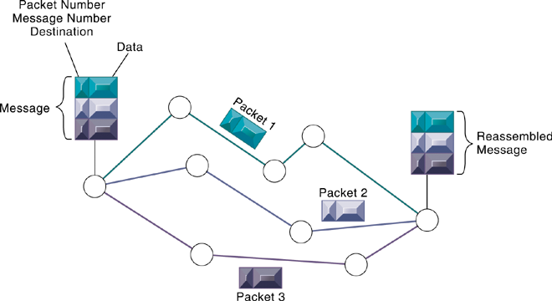
Essentials of Management Information Systems
Chapter 7 Telecommunications, the Internet, and
Wireless Technology
Principal components of telecommunications networks and key networking technologies?
Packet-Switched Networks and Packet Communications
Data are grouped into small packets, which are transmitted independently over various communications channels and reassembled at their final destination.
Figure 7.3
Notes:
This graphic illustrates how packet switching works, showing a message being split into three packets, sent along different routes, and then reassembled at the destination. Note that each packet contains a packet number, message number, and destination.

Slide 15
Essentials of Management Information Systems
Chapter 7 Telecommunications, the Internet, and
Wireless Technology
Principal components of telecommunications networks and key networking technologies?
Key Digital Networking Technologies
TCP/IP and connectivity
  Connectivity between computers enabled by protocols
  Protocols: rules that govern transmission of information between two points
  Transmission Control Protocol/Internet Protocol (TCP/IP)
    Common worldwide standard that is basis for Internet
  Department of Defense reference model for TCP/IP
    Four layers
      Application layer
      Transport layer
      Internet layer
      Network interface layer
Notes:
This slide continues the discussion of the three main networking technologies in use today, and looks at the third TCP/IP. Note that in a network, there are typically many different types of hardware and software components that need to work together to transmit and receive information. Different components in a network communicate with one another only by adhering to a common set of rules called protocols. In the past, many diverse proprietary and incompatible protocols often forced business firms to purchase computing and communications equipment from a single vendor. But today, corporate networks are increasingly using a single, common, worldwide standard called Transmission Control Protocol/
Internet Protocol (TCP/IP). TCP/IP actually is a suite of protocols, the main ones of which are TCP and IP. Ask students what these two main protocols are responsible for.

Slide 16
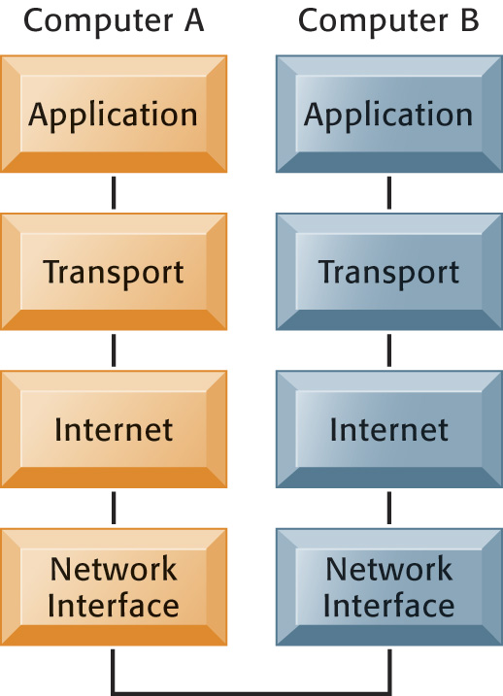
Essentials of Management Information Systems
Chapter 7 Telecommunications, the Internet, and
Wireless Technology
Principal components of telecommunications networks and key networking technologies?
The Transmission Control Protocol/Internet Protocol (TCP/IP) Reference Model
This figure illustrates the four layers of the TCP/IP reference model for communications.
Figure 7.4
Notes:
This graphic illustrates the four layers of the DOD reference model for TCP/IP. Note that what happens, when computer A sends a message to computer B, is that the data that computer A creates is transferred within that computer from the application layer to subsequent layers in sequence. In this process it is split into packets, and information is added at each stage, ultimately translating the packets into a form that can be transferred over the network interface. After traveling over the network interface, the packets are reassembled at the recipient computer, from the network interface layer up, ultimately for use by the application layer.

Slide 17
Essentials of Management Information Systems
Chapter 7 Telecommunications, the Internet, and
Wireless Technology
What are the different types of networks?
Types of Networks
Digital versus analog signals
  Modem: translates digital signals into analog form
Local-area networks (LANs)
  Ethernet is standard for physical medium
  Workgroup network model (peer-to-peer architecture)
  Windows domain network model
Campus-area networks (CANs)
Wide-area networks (WANs)
Metropolitan-area networks (MANs)
Notes:
This slide looks at the types of networks that organizations use. Ask students what the differences are between digital and analog signals. Ask students to describe and distinguish between LANs, CANs, WANs, and MANs, and also to talk about their different range of operation. Note that a network can be defined by the way the clients interact (client/server versus peer-to-peer); the type of physical medium to carry signals (Ethernet, Giga Ethernet, etc.)

Slide 18
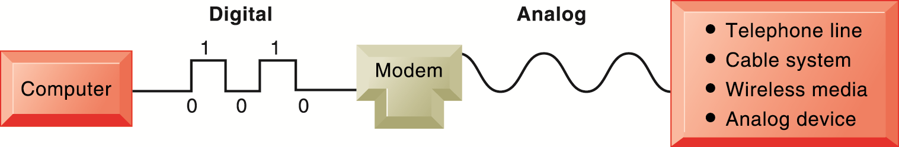
Essentials of Management Information Systems
Chapter 7 Telecommunications, the Internet, and
Wireless Technology
What are the different types of networks?
Functions of the Modem
A modem is a device that translates digital signals into analog form (and vice versa) so that computers can transmit data over analog networks such as telephone and cable networks.
Figure 7.5
Notes:
This graphic illustrates the differences between digital and analog signals, and shows how digital signals can be sent to other computers over analog cables such as telephone and cable lines which are analog. Note that digital signals are representations of the two binary digits, 0 and 1, and are represented logically as on and off electrical pulses (in reality as different voltages). Ask students what MODEM stands for.

Slide 19
Essentials of Management Information Systems
Chapter 7 Telecommunications, the Internet, and
Wireless Technology
What are the different types of networks?
Transmission Media and Transmission Speeds
Transmission media:
  Types: twisted pair wire, coaxial cable, wireless
  Speeds: Wide range depending on software/hardware combination
Transmission speed
  Bps, Mbps: rate of information transmitted
  Hertz: Number of cycles per second
  Bandwidth: Difference between highest and lowest frequencies on single channel
Notes:
This slide looks at the media involved in network transmission. Note that traditional telephone systems in buildings had
twisted wires installed for analog communication, but they can be used for digital communication as well.
Note that the transmission capacity of a medium (bps) is dependent on its frequency, which is measured in hertz, or cycles per second. Ask students to define bandwidth (it is the difference between the highest and lowest frequencies that can be accommodated on a single channel.)

Slide 20
Essentials of Management Information Systems
Chapter 7 Telecommunications, the Internet, and
Wireless Technology
How the Internet works and supports e-business
What Is the Internet?
World’s most extensive network
Internet service providers (ISPs) provide connections
  Digital subscriber line
  Cable Internet connections
  T1 lines
Notes:
This slide examines what the Internet is—ask students to describe it and what they use it for. The text refers to the Internet as the most extensive public communication system and the world’s largest implementation of client/server computing.
Ask students how they connect to the Internet. Do any of their families use dial-up (telephone/modem)? Do any use satellite? Note that T lines are leased, dedicated lines suitable for businesses or government agencies requiring high-speed guaranteed service levels. Do students know that the Internet does not guarantee any service level, and only agrees to make a “best effort.”
Ask students what an IP address is used for. Ask students why we have a domain name system, and why we don’t just use IP addresses. Note that the domain name system makes it possible for people to remember addresses.

Slide 21
Essentials of Management Information Systems
Chapter 7 Telecommunications, the Internet, and
Wireless Technology
How the Internet works and supports e-business
Internet addressing and architecture
  IP addresses
The Domain Name System (DNS)
  converts IP addresses to domain names
  Hierarchical structure
  Top-level domains
Internet architecture and governance
  No formal management: IAB, ICANN, W3C
  The future Internet: IPv6 and Internet2
Notes:
Ask students what an IP address is used for. Ask students why we have a domain name system, and why we don’t just use IP addresses. Note that the domain name system makes it possible for people to remember addresses.

Slide 22
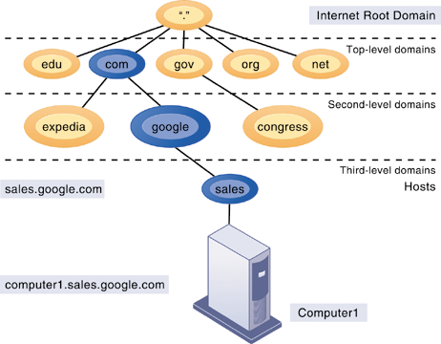
Essentials of Management Information Systems
Chapter 7 Telecommunications, the Internet, and
Wireless Technology
How the Internet works and supports e-business
The Domain Name System
The Domain Name System is a hierarchical system with a root domain, top-level domains, second-level domains, and host computers at the third level.
Figure 7.6
Notes:
This graphic describes how the domain name system works. Note that the “root” domain is the period that is used before the top-level domain, such as .edu or .com. Give students an example Internet address, such as myserver.myspace.com and ask them what the top-, second-, and third-level domains are.

Slide 23
Essentials of Management Information Systems
Chapter 7 Telecommunications, the Internet, and
Wireless Technology
How the Internet works and supports e-business
Internet architecture and governance
  Network service providers
    Own trunk lines (high-speed backbone networks)
  Regional telephone and cable TV companies
    Provide regional and local access
  Professional organizations and government bodies establish Internet standards
    IAB
    ICANN
    W3C
Notes:
Many different organizations are involved in the operation and management of the Internet including the owners of the major trunk lines (Network Service Providers), regional TELCOs and Cable systems, and professional technical organizations that set standards. In the U.S. government agencies like the FCC will play a growing role in regulating the Internet now that it has been declared a common carrier just like the telephone system.

Slide 24
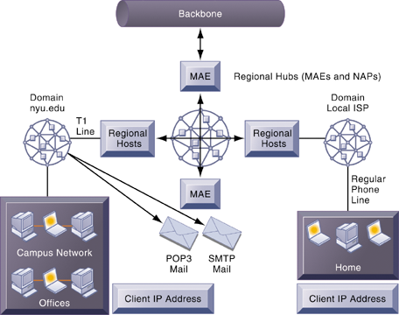
Essentials of Management Information Systems
Chapter 7 Telecommunications, the Internet, and
Wireless Technology
How the Internet works and supports e-business
Internet Network Architecture
The Internet backbone connects to regional networks, which in turn provide access to Internet service providers, large firms, and government institutions. Network access points (NAPs) and metropolitan area exchanges (MAEs) are hubs where the backbone intersects regional and local networks and where backbone owners connect with one another.
Figure 7.7
Notes:
This graphic illustrates the architecture of the Internet. Note that MAEs (metropolitan area exchanges) are hubs where the backbone intersects regional and local networks and where backbone networks connect with one another.

Slide 25
Essentials of Management Information Systems
Chapter 7 Telecommunications, the Internet, and
Wireless Technology
The Battle over Net Neutrality
Interactive Session: Organizations
The Battle over Net Neutrality
Read the Interactive Session and then discuss the following questions:
  What is network neutrality? Why has the Internet operated under net neutrality up to this point in time?
  Who’s in favor of net neutrality? Who’s opposed? Why?
  What would be the impacts on individual users, businesses, and government if Internet providers switched to a tiered service model?
  Are you in favor of legislation enforcing network neutrality? Why or why not?
Notes:
Refer to the video cases for this chapter for more on network neutrality. Ask students if this debate is a political debate among large Internet players, or is it a moral and ethical issue? Or is this debate all about financial advantage? Principles or profits? Ask students to find analogies, such as toll highways versus freeways, or peak time pricing for electricity. Should trucks be charged a higher fee for the use of highways than autos because they cause greater wear and tear on roads given their weight? In many states, if not all, trucks pay much larger fees due to their destructive effect on highways. On the Internet, should really heavy users like Netflix pay extra for their bandwidth usage (now about 37% of the entire Internet in the US)?

Slide 26
Essentials of Management Information Systems
Chapter 7 Telecommunications, the Internet, and
Wireless Technology
How the Internet works and supports e-business
The Future Internet: IPv6 and Internet 2
  IPv6
    New addressing scheme for IP numbers
    Will provide more than a quadrillion new addresses
    Not compatible with current IPv5 addressing
  Internet2
    Advanced networking consortium
      Universities, businesses, government agencies, other institutions
    Developed high-capacity 100 Gbps testing network
    Testing leading-edge new technologies for Internet

Slide 27
Essentials of Management Information Systems
Chapter 7 Telecommunications, the Internet, and
Wireless Technology
How the Internet works and supports e-business
Internet Services
Internet services
  E-mail
  Chatting and instant messaging
  Newsgroups
  Telnet
  File Transfer Protocol (FTP)
  World Wide Web
VoIP
Unified communications
Virtual private network (VPN)
Notes:
This slide continues the discussion about what the Internet is, here looking at the services, or applications, that the Internet supports. Notice that the Internet comprises many more services than just e-mail and the Web. Ask students which of these services, beyond e-mail and the World Wide Web have they used, and if they have, to describe how it works. Students who have cable Internet telephones are using VoIP.
Other popular technologies that use the Internet as a platform are VoIP, unified communications, and virtual private networks. Ask students what they think is the value to business is of each of these technologies.

Slide 28
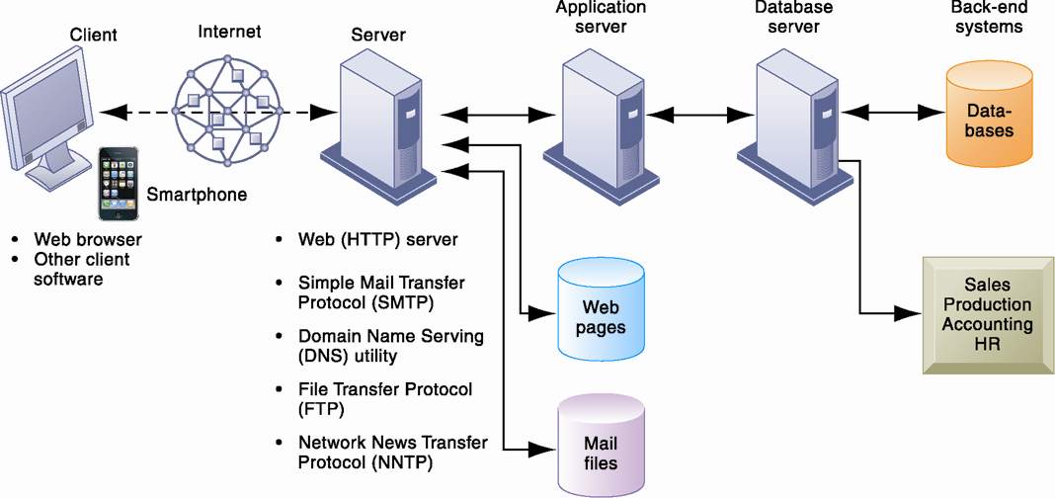
Essentials of Management Information Systems
Chapter 7 Telecommunications, the Internet, and
Wireless Technology
How the Internet works and supports e-business
Client/Server Computing on the Internet
Figure 7.8
Client computers running Web browser and other software can access an array of services on servers over the Internet. These services may all run on a single server or on multiple specialized servers.
Notes:
This graphic looks at the services that an Internet server computer can offer: Web sites (HTTP), e-mail (SMTP), file transfer (FTP), newsgroups (NNTP). It illustrates where on the path between client and backend systems these services lie.

Slide 29
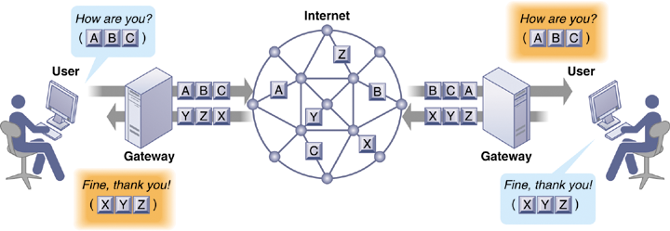
Essentials of Management Information Systems
Chapter 7 Telecommunications, the Internet, and
Wireless Technology
How the Internet works and supports e-business
How Voice over IP Works
A VoIP phone call digitizes and breaks up a voice message into data packets that may travel along different routes before being reassembled at the final destination. A processor nearest the call’s destination, called a gateway, arranges the packets in the proper order and directs them to the telephone number of the receiver or the IP address of the receiving computer.
Figure 7.9
Notes:
This graphic shows how VoIP works. The voice messages are digitized and transported over the Internet in the same packet-switching method as traditional Internet data. Gateways are simply computers (network devices) that maintain the interface with the Internet in a firm.

Slide 30
Essentials of Management Information Systems
Chapter 7 Telecommunications, the Internet, and
Wireless Technology
Monitoring Employees on Networks: Unethical?
Interactive Session: People
Monitoring Employees on Networks: Unethical or Good Business?
Read the Interactive Session and then discuss the following questions:
1. Should managers monitor employee email and Internet usage? Why or why not?
2. Describe an effective email and web use policy
for a company.
3. Should managers inform employees that their web behavior is being monitored? Or should managers monitor secretly? Why or why not?

Slide 31
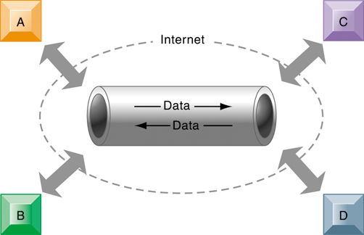
Essentials of Management Information Systems
Chapter 7 Telecommunications, the Internet, and
Wireless Technology
How the Internet works and supports e-business
A Virtual Private Network Using the Internet
Figure 7.10
This VPN is a private network of computers linked using a secure “tunnel” connection over the Internet. It protects data transmitted over the public Internet by encoding the data and “wrapping” them within the Internet Protocol (IP). By adding a wrapper around a network message to hide its content, organizations can create a private connection that travels through the public Internet.
Notes:
This graphic illustrates how a virtual private network works. The rectangles A, B, C, and D represent different computers on the VPN. In a process called tunneling, packets of data are encrypted and wrapped inside IP packets. By adding this wrapper around a network message to hide its content, business firms create a private connection that travels through the public Internet.

Slide 32
Essentials of Management Information Systems
Chapter 7 Telecommunications, the Internet, and
Wireless Technology
How the Internet works and supports e-business
The Web
HTML (Hypertext Markup Language):
  Formats documents for display on Web
Hypertext Transfer Protocol (HTTP):
  Communications standard used for transferring Web pages
Uniform resource locators (URLs):
  Addresses of Web pages
    E.g., http://www.megacorp.com/content/features/082602.html
Web servers
    Software for locating and managing Web pages
Notes:
This slide looks at one of the most popular services on the Internet, the Web, and the main protocols enabling the Web. The Web is an interlinked connection of Web sites, which are collections of Web pages linked to a home page. These pages are created using a text markup language call HTML, and transmitted to user’s Web browsers by HTTP. Web page addresses (URLs) are composed of the domain name of the Web site and the file location of the individual Web page. Ask students if any have created Web pages using HTML, and if so, to describe what this is like. How have they made the Web pages visible to others on the Web? There is a learning track available online that shows students how to create Web pages using basic HTML.

Slide 33
Essentials of Management Information Systems
Chapter 7 Telecommunications, the Internet, and
Wireless Technology
How the Internet works and supports e-business
  Searching for information on the Web
    Search engines
      Early1990s engines used keyword indexes
      Google implemented page ranking
    Mobile search – now 50% of all searches in 2015
    Semantic search
      Goal is to include understanding of human language and behavior to deliver more relevant results
    Predictive search- Guesses what you’re looking for
Notes:
This slide looks at how people find information of interest on the Web. The primary method is through search engines, which today act as major portals to the Web. Ask students where their initial points of entry are on the Web, and how they find information they are interested in. Most will be Google users, but ask if they have looked at Bing, the Microsoft search engine.
The text discusses how big the Web is, in terms of pages. Google visited and indexed the content of over an estimated 50 billion Web pages in 2011, but this does not include the “deep Web.” Other estimates point to one trillion Web pages, but many of these are duplicates. Ask students what the “deep Web” is. Web sites and pages available only to subscribers for a fee (“premium content”) do not allow crawlers to index the pages.

Slide 34
Essentials of Management Information Systems
Chapter 7 Telecommunications, the Internet, and
Wireless Technology
How the Internet works and supports e-business
    Search engine marketing – Major source of Internet advertising revenue
    Social search
      Effort to provide more relevant results by including pages visited by user’s social network
      Google +1, Facebook Like
Notes:
This slide looks at how people find information of interest on the Web. The primary method is through search engines, which today act as major portals to the Web. Ask students where their initial points of entry are on the Web, and how they find information they are interested in. Most will be Google users, but ask if they have looked at Bing, the Microsoft search engine that is showing some promise.
The text discusses how big the Web is, in terms of pages. Google visited and indexed the content of over an estimated 50 billion Web pages in 2011, but this does not include the “deep Web.” Other estimates point to “one trillion” Web pages, but many of these are duplicates. Ask students what the “deep Web” is. Web pages a available only to subscribers for a fee (“premium content”) do not allow crawlers to index the pages.

Slide 35
Essentials of Management Information Systems
Chapter 7 Telecommunications, the Internet, and
Wireless Technology
How the Internet works and supports e-business
    Visual search- facial recognition software
    Intelligent agent shopping bots – intelligent agent software for searching Internet for shopping information, e.g. PriceGrabber
    SEO – process of improving rankings in search engine results with search engine optimization
      Google updates algorithm to mitigate link farming
Notes:
Shopping bots are always fun to visit in class. Ask students what they might be interested in having you shop for, and then use one of the shop bots like Shopzilla or Pricegrabber. Visit Pinterest in class, or Instagram, to see how visual sites use visual search.

Slide 36
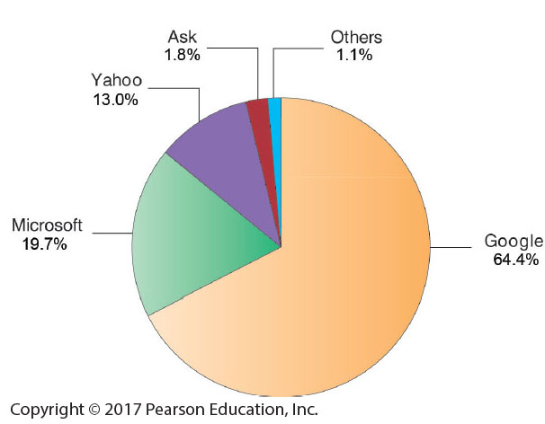
Essentials of Management Information Systems
Chapter 7 Telecommunications, the Internet, and
Wireless Technology
How the Internet works and supports e-business
Top U.S. Web Search Engines
Figure 7.11
Google is the most popular search engine on the Web, handling 67 percent of all Web searches.
Notes:
This graphic ranks the major search engines according to popularity, or percentage of total number of searches performed. Google is a clear favorite. Is this due to the superiority of their search engine results or does it involve other factors such as their clean interface, or their reach, which makes their ad platform more valuable to advertisers. Poll your class about the search engines they use. Do searches on various topics using Facebook search and compare to Google search.

Slide 37
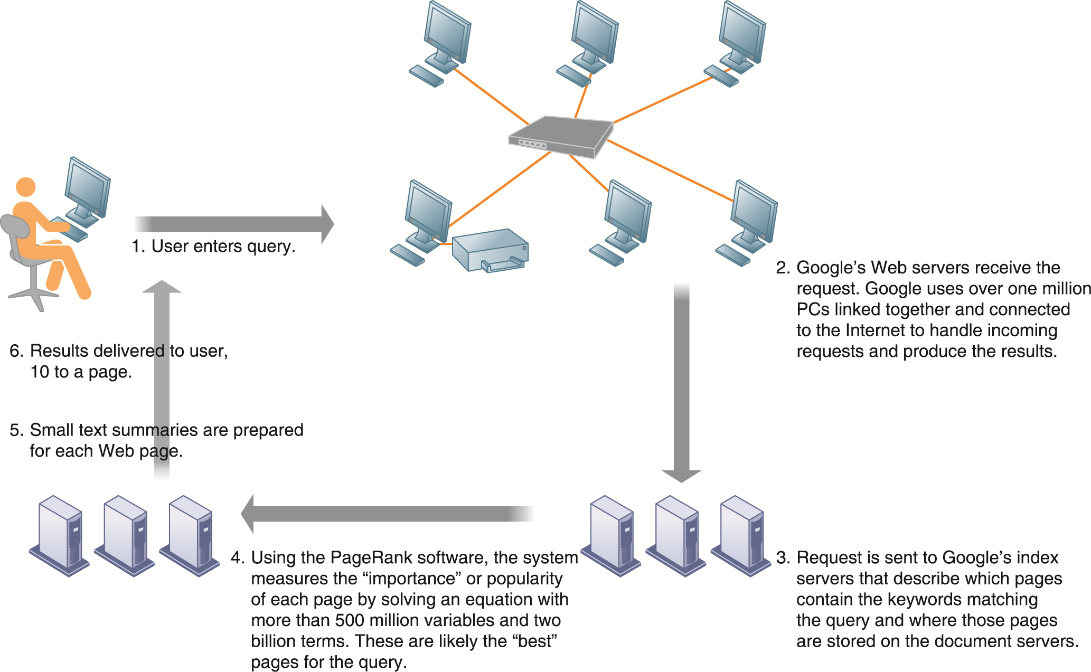
Essentials of Management Information Systems
Chapter 7 Telecommunications, the Internet, and
Wireless Technology
How the Internet works and supports e-business
How Google Works
The Google search engine is continuously crawling the Web, indexing the content of each page, calculating its popularity, and storing the pages so that it can respond quickly to user requests to see a page. The entire process takes about one-half second.
Figure 7.12
Notes:
This graphic illustrates in a very high level diagram how Google works. At the foundation of Google’s search engine are two concepts—page ranking and the indexing of combinations of words. Ask students if they have a favorite search engine, and if so, why that search is their favorite. The reality of how Google actually works is the subject of many volumes, and is beyond the scope of this book.

Slide 38
Essentials of Management Information Systems
Chapter 7 Telecommunications, the Internet, and
Wireless Technology
How the Internet works and supports e-business
Web 2.0
Second-generation services enabling people to collaborate, share information, and create new services online
Blogs: chronological, informal Web sites created by individuals
RSS (Really Simple Syndication): syndicates Web content so aggregator software can pull content for use in another setting or viewing later
Wikis: collaborative Web sites where visitors can add, delete, or modify content on the site
Social networking sites – enable users to build communities of friends and share information
Notes:
This slide discusses Web 2.0 services. Software mashups and widgets were discussed in Chapter 5.
Ask if students use a blog reader, such as Google Reader, to read their blogs. How many have created blogs? What blogging service did they use? How many have used RSS to pull in the content from their blogs to read them in one place. Note that wikis are used in business to share information. The text cites the example of Motorola, whose sales reps use wikis to share sales information. Instead of developing a different pitch for each client, reps reuse the information posted on the wiki. How do companies use blogs and RSS?

Slide 39
Essentials of Management Information Systems
Chapter 7 Telecommunications, the Internet, and
Wireless Technology
How the Internet works and supports e-business
Web 3.0 and the Future Web
Developing techniques to make searching Web more productive and meaningful
“Semantic Web”
  A collaborative effort led by W3C to add layer of meaning to the existing Web
Ways to make Web more “intelligent” and intuitive
“Internet of Things”
More widespread use of cloud computing, mobile computing
Notes:
New slide

Slide 40
Essentials of Management Information Systems
Chapter 7 Telecommunications, the Internet, and
Wireless Technology
The Wireless Revolution
Cellular systems
  Competing standards for cellular service
    CDMA: United States only
    GSM: Rest of world, AT&T, T-Mobile
  Third-generation (3G) networks
    Higher transmission speeds suitable for web browsing but not Web browsing
  Fourth-generation (4G) networks
    Entirely packet-switched
    Up to 100 Mbps
Notes:
This slide discusses the continuing revolution in wireless communication. Ask students what changes or improvements have happened in their cell phone service over the past two years. Have they purchased or upgraded a cell phone in that time, and if so, why?
Note that “3G networks are widely used in Japan, South Korea, Taiwan, Hong Kong, Singapore, and parts of northern Europe, but such services are not yet available in many U.S. locations. To compensate, U.S. cellular carriers have upgraded their networks to support higher-speed transmission. These interim 2.5G networks provide data transmission rates ranging from 60 to 354 Kbps, enabling cell phones to be used for Web access, music downloads, and other broadband services.” How many students are using 3G phones? Apple’s newest iPhone uses a 3G network. Do users note the difference? The next evolution in wireless communication, termed 4G, will be entirely packet-switched and capable of providing between 1 Mbps and 1 Gbps speeds, with premium quality and high security.

Slide 41
Essentials of Management Information Systems
Chapter 7 Telecommunications, the Internet, and
Wireless Technology
The Wireless Revolution
Wireless computer networks and Internet access
  Bluetooth (802.15)
    Links up to 8 devices in 10-m area using low-power, radio-based communication
    Useful for personal networking (PANs)
  Wi-Fi (802.11)
    Set of standards: 802.11a, 802.11b, 802.11g, 802.11n
    Used for wireless LAN and wireless Internet access
    Use access points: device with radio receiver/transmitter for connecting wireless devices to a wired LAN
Notes:
This slide discusses the current standards in wireless networking. Ask students if they have any Bluetooth or wireless devices they use for computing, such as keyboards, earphones, or other. Note that in most Wi-Fi communications, wireless devices communicate with a wired LAN using an access point.

Slide 42
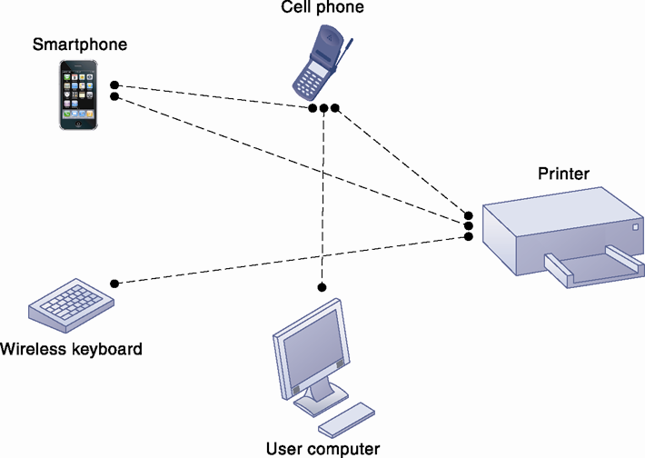
Essentials of Management Information Systems
Chapter 7 Telecommunications, the Internet, and
Wireless Technology
The Wireless Revolution
A Bluetooth Network (PAN)
Bluetooth enables a variety of devices, including cell phones, PDAs, wireless keyboards and mice, PCs, and printers, to interact wirelessly with each other within a small 30-foot (10-meter) area. In addition to the links shown, Bluetooth can be used to network similar devices to send data from one PC to another, for example.
Figure 7.13
Notes:
This graphic illustrates the uses of Bluetooth for a PAN. Bluetooth connects wireless keyboards and mice to PCs or cell phones to earpieces without wires. Bluetooth has low-power requirements, making it appropriate for battery-powered handheld computers, and cell phones. Most cell phones today are Bluetooth enabled, allowing them to connect to other wireless devices (like earphones) and PCs.

Slide 43
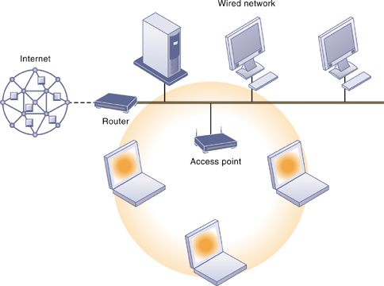
Essentials of Management Information Systems
Chapter 7 Telecommunications, the Internet, and
Wireless Technology
The Wireless Revolution
An 802.11 Wireless LAN
Mobile laptop computers equipped with wireless network interface cards link to the wired LAN by communicating with the access point. The access point uses radio waves to transmit network signals from the wired network to the client adapters, which convert them into data that the mobile device can understand. The client adapter then transmits the data from the mobile device back to the access point, which forward the data to the wired network.
Figure 7.14
Notes:
This graphic illustrates an 802.11 wireless LAN operating in infrastructure mode that connects a small number of mobile devices to a larger wired LAN. Most wireless devices are client machines. The servers that the mobile client stations need to use are on the wired LAN. The access point controls the wireless stations and acts as a bridge between the main wired LAN and the wireless LAN. (A bridge connects two LANs based on different technologies like your wireless network to your BlueRay player so you can download Internet movies from Netflix and watch them on your TV). The access point also controls the wireless stations.

Slide 44
Essentials of Management Information Systems
Chapter 7 Telecommunications, the Internet, and
Wireless Technology
The Wireless Revolution
Wireless computer networks and Internet access
  Wi-Fi (cont.)
    Hotspots: one or more access points in public place to provide maximum wireless coverage for a specific area
    Weak security features
  WiMax (802.16)
    Wireless access range of 31 miles
    Require WiMax antennas
Notes:
This slide continues the discussion about wireless networking and Wi-Fi. Ask students if they have ever connected to the Internet through a hotspot at an airport, coffee shop, hotel, or other location. Was there any security?
Ask students what other drawbacks, beside security, there are to Wi-Fi (roaming difficulties, interference). Note that wireless networks based on the upcoming 802.11n specification will solve interference problems by using multiple wireless antennas in tandem to transmit and receive data and technology to coordinate multiple simultaneous radio signals. What is this technology called? (MIMO).

Slide 45
Essentials of Management Information Systems
Chapter 7 Telecommunications, the Internet, and
Wireless Technology
The Wireless Revolution
Radio frequency identification (RFID)
  Use tiny tags with embedded microchips containing data about an item and location
  Tag antennas to transmit radio signals over short distances to special RFID readers, which send data over network to computer for processing
  Common uses:
    Automated toll-collection
    Tracking goods in a supply chain
  Requires companies to have special hardware and software
  Reduction in cost of tags making RFID viable for many firms
Notes:
This slide introduces one of two wireless technologies having a major impact on business, radio frequency ID. Ask students for examples of where RFID is used today. The text provides the example of Wal-Mart using RFID to manage inventory and supply chains. Ask students how this works.

Slide 46
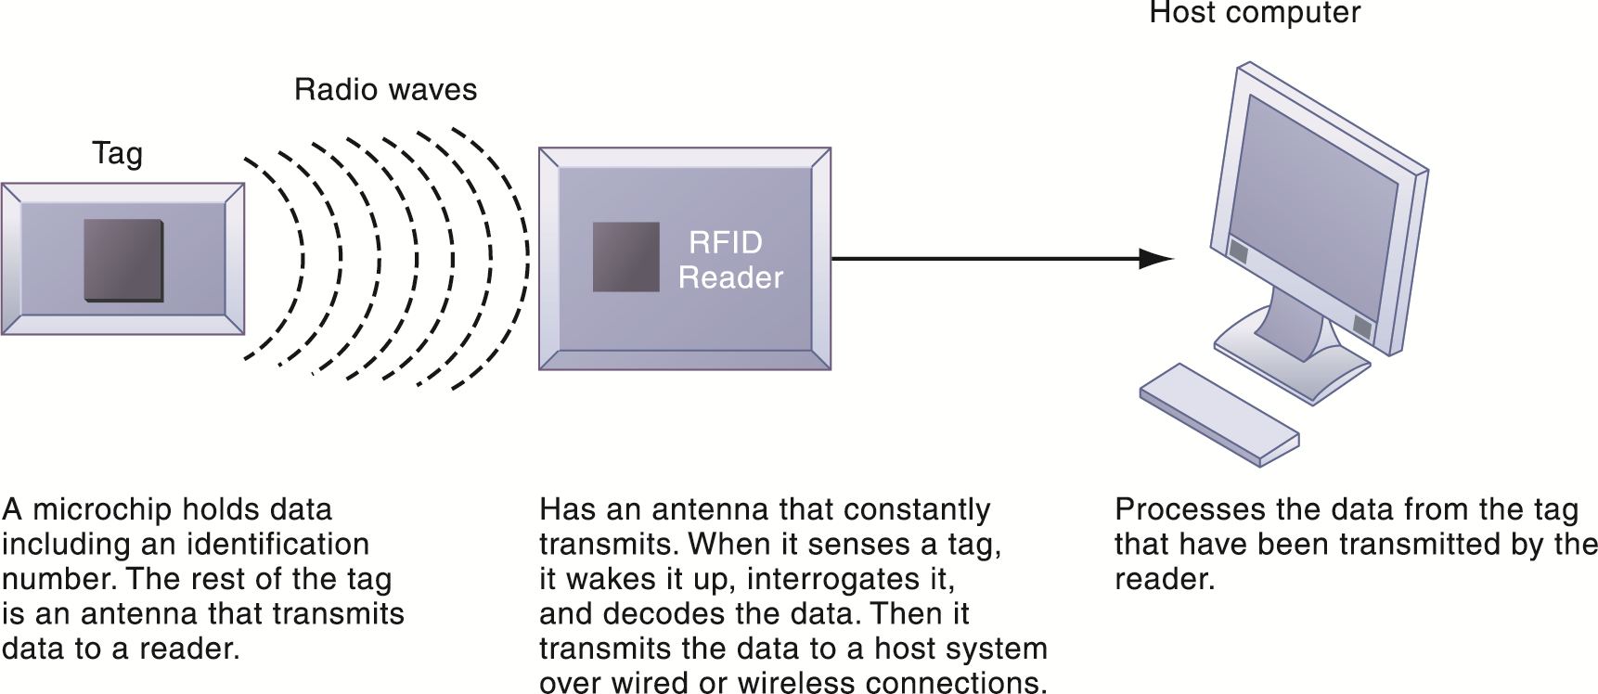
Essentials of Management Information Systems
Chapter 7 Telecommunications, the Internet, and
Wireless Technology
The Wireless Revolution
How RFID Works
RFID uses low-powered radio transmitters to read data stored in a tag at distances ranging from 1 inch to 100 feet. The reader captures the data from the tag and sends them over a network to a host computer for processing.
Figure 7.15
Notes:
This graphic illustrates how RFID works.
Ask students if RFID potentially poses any ethical problems.

Slide 47
Essentials of Management Information Systems
Chapter 7 Telecommunications, the Internet, and
Wireless Technology
The Wireless Revolution
Wireless sensor networks (WSNs)
  Networks of hundreds or thousands of interconnected wireless devices embedded into physical environment to provide measurements of many points over large spaces
  Used to monitor building security, detect hazardous substances in air, monitor environmental changes, traffic, or military activity
  Devices have built-in processing, storage, and radio frequency sensors and antennas
  Require low-power, long-lasting batteries and ability to endure in the field without maintenance
  Major sources of “Big Data” and fueling “Internet of Things”
Notes:
This slide introduces a second wireless technology having a major impact on business, wireless sensor networks. Note that the wireless sensors are linked into an interconnected network that routes the data to a computer for analysis.

Slide 48
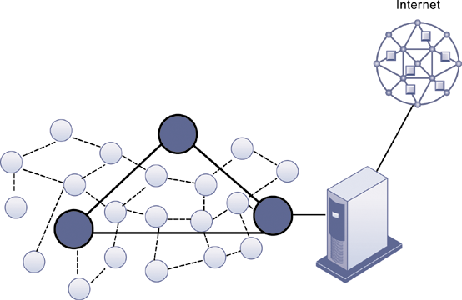
Essentials of Management Information Systems
Chapter 7 Telecommunications, the Internet, and
Wireless Technology
The Wireless Revolution
A Wireless Sensor Network
The small circles represent lower-level nodes and the larger circles represent high-end nodes. Lower-level nodes forward data to each other or to higher-level nodes, which transmit data more rapidly and speed up network performance.
Figure 7.16
Notes:
This graphic illustrates the lower level nodes and higher level nodes at work in a wireless sensor network. Note that the server that data from the sensors is sent to acts as a gateway to a network based on Internet technology.

